Slide 1


Department of Computer Science and Engineering
Chest X-ray Image Based Report Generation
Using Deep Learning
Under the guidance of
Presented By:
Mrs. D.V. Padmavathi, M.Tech
Assistant Professor
Department of CSE
T. Meghana (20KH1A05A6)
N. Pravallika (20U41A0570)
K. Venkateswar Reddy (20KH1A05C4)
S. Ganesh (20KH1A05A1)
NIT
Department of Computer Science and Engineering

Slide 2

OBJECTIVES
The main aim of this project is, as it gives high accuracy of chest X-ray report generation automatically, it reduces the burden on the radiologists and improves the patient health.
NIT
Department of Computer Science and Engineering

Slide 3

ABSTRACT
Chest X-ray (CXR) imaging plays a pivotal role in diagnosing a wide range of thoracic conditions, yet the manual generation of radiological reports remains time-consuming and subjective. The application of deep learning in generating radiological reports from chest X-ray (CXR) images.
In this project, by employing convolutional neural networks (CNNs) for feature extraction and natural language processing (NLP) for text generation, this approach automates the traditionally labor-intensive process of report creation. Overall, CXR image-based report generation using deep learning holds significant promise for enhancing diagnostic efficiency and patient care in radiology.
NIT
Department of Computer Science and Engineering

Slide 4
INTRODUCTION
Image Preprocessing: CXR images often vary in terms of orientation, contrast, and noise. Preprocessing techniques such as resizing, normalization, and noise reduction are applied to standardize the input images and enhance their quality, facilitating more robust feature extraction by the deep learning model.
Feature Extraction: Convolutional neural networks are employed to automatically extract relevant features from CXR images. Through multiple layers of convolutional and pooling operations, the network learns to capture hierarchical representations of image features, ranging from simple edges and textures to complex anatomical structures and pathological abnormalities.
Abnormality Detection: Trained deep learning models are capable of detecting various abnormalities present in CXR images, including consolidations, nodules, infiltrates, and effusions.
3
NIT
Department of Computer Science and Engineering

Slide 5
Report Generation: Once abnormalities are detected, natural language processing (NLP) techniques are utilized to generate descriptive reports based on the findings. These reports typically include information about the detected abnormalities, their location, size, and clinical significance. NLP models can be trained on large corpora of annotated CXR reports to generate coherent and clinically relevant textual descriptions automatically.
Validation and Interpretation: Generated reports are subjected to validation by medical professionals, such as radiologists, to ensure accuracy and clinical relevance. Human experts may review the CXR images alongside the generated reports to verify the correctness of the findings and provide additional insights or corrections if necessary.
NIT
Department of Computer Science and Engineering

Slide 6
LITERATURE SURVEY
Title: X-Ray Medical Reports using Deep Learning
Year: 2020
Author: Islam Akef Ebeid
In this paper, they proposed a model that uses medical imaging to diagnose and treat diseases. The features are used to discover diseases automatically. This model have to look at many images containing a lot of variation and produce a templated report describing abnormalities consisting of findings and an impressions section.
NIT
Department of Computer Science and Engineering

Slide 7
Title: Multi-Label Learning with Visual-Semantic Embedded Knowledge Graph for Diagnosis of Radiology Imaging
Year:2021
Author: Daibing Hou, Zijian Zhao, Sanyuan Hu
In this paper, they proposed a method with a unified weakly-supervised multi-label image classification framework by tailoring deep CNN (DCNN) architectures. Based on clinical taxonomies, a deep hierarchical multi-label classification (HMLC) approach for CXR CAD, and the abnormality labels were a constructed hierarchy from the dataset.
NIT
Department of Computer Science and Engineering

Slide 8
Title: A framework based on the encoder-decoder architecture equipped with
the multi-attention mechanism.
Year: 2022
Author: Kaur and Mittal
In this paper, they proposed the model without compromising the accuracy. Here the encoder understands the image and after analyzing it sends to decoder. Now the decoder will analyze the data and provides the output with complete accuracy and efficiency.
NIT
Department of Computer Science and Engineering

Slide 9
EXISTING SYSTEM
By using the SVM algorithm, the existing system of CXR image has the challenges, such as, handling variability in imaging conditions, dealing with rare or complex cases, and ensuring the generalization of models to diverse patient populations remain areas of active research. Difficult to categorize the type of disease in some unknown cases.
DISADVANTAGES
Limited Accuracy
Difficulty with Rare or Complex Cases
Interpretability and Trustworthiness
NIT
Department of Computer Science and Engineering

Slide 10
PROPOSED SYSTEM
To improve the quality of analyzing the CXR image, the Deep Learning Technology, such as CNN (Convolutional Neural Network) is used. The CNN effectively helps to segregate the image and deals with the complex and rare cases. The preprocessing, training, validation and deployment stages in the CNN technology will correctly diagnose the problem and shows the accurate results.
ADVANTAGES
Improved Accuracy and Sensitivity
Automation and Efficiency
Consistency and Standardization
NIT
Department of Computer Science and Engineering

Slide 11
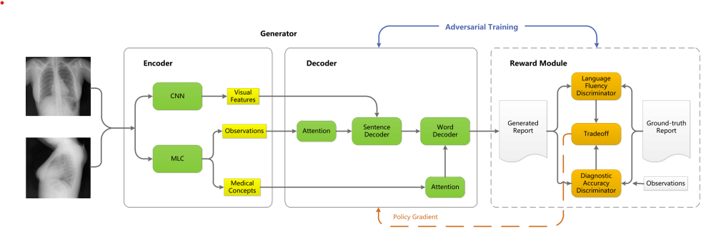
SYSTEM ARCHITECTURE
NIT
Department of Computer Science and Engineering

Slide 12
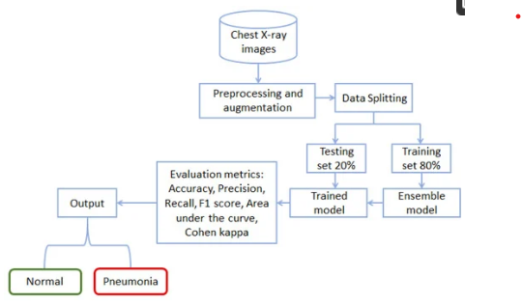
FLOW DIAGRAM
NIT
Department of Computer Science and Engineering

Slide 13
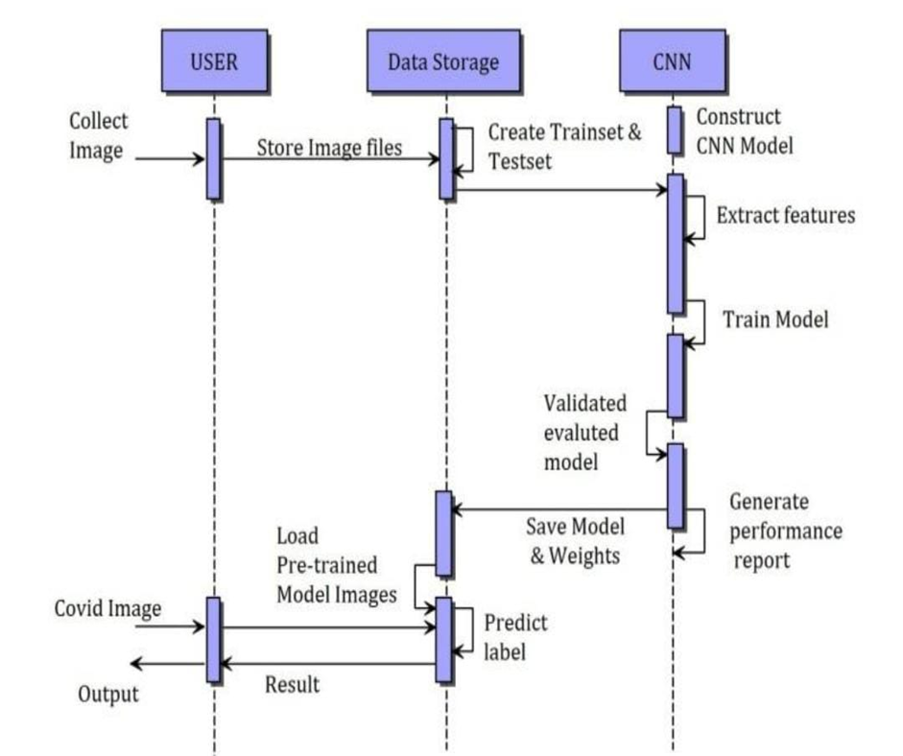


SEQUENCE DIAGRAM

Slide 14
SYSTEM REQUIREMENTS
HARDWARE REQUIREMENTS:
Processor : 11th Gen Intel(R) Core(TM) i5
RAM : 16GB DDR4
SSD : 512 SSD
NIT
Department of Computer Science and Engineering

Slide 15
SYSTEM REQUIREMENTS
SOFTWARE REQUIREMENTS:
Programming Language : Python
Operating System : Windows 11
NIT
Department of Computer Science and Engineering

Slide 16

MODULES
Upload X-RAY image dataset
Preprocessing & Feature Extraction
Generate Train & Test Model
Generate Deep Learning CNN Model
Get Drive HQ Images

Slide 17
1. Upload X-Ray Image Dataset:
Using this module, we are uploading X-RAY train images and then application read all images and convert them grey format. This dataset is a valuable resource for researchers, clinicians, and developers interested in leveraging scan data for various applications.
2. Preprocessing and Feature Extraction:
Preprocessing and feature extraction are iterative processes and often require domain knowledge and experimentation to determine the most effective techniques for a given dataset and modeling task.
3. Generate Train and Test Model:
Using this module, we split dataset into train and test model to calculate accuracy using test images by applying train model on it. Training and testing a machine learning model involves several steps, typically performed using a labelled dataset.

Slide 18

4. Generate Deep learning CNN Model:
Using this module, we will build array of pixels with all images features and then split dataset into train and test model to calculate accuracy using test images by applying train model on it. We use the CNN and reinforcement model in the completion of the project.
5. Get Drive HQ Images:
Using this module will input train and test data to auto stack CNN model to build training classifier. The output is also images that contains the automated report written on the image.

Slide 19
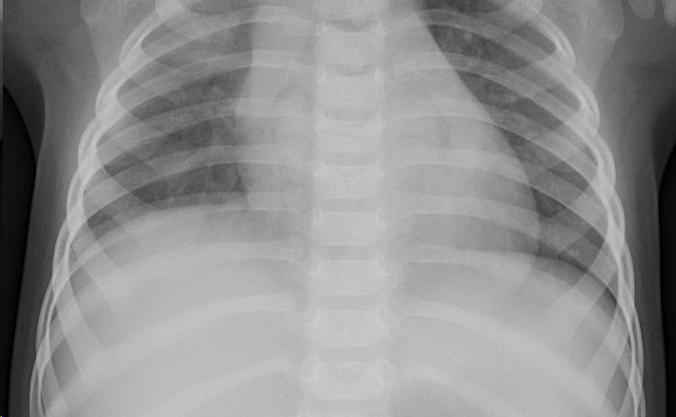
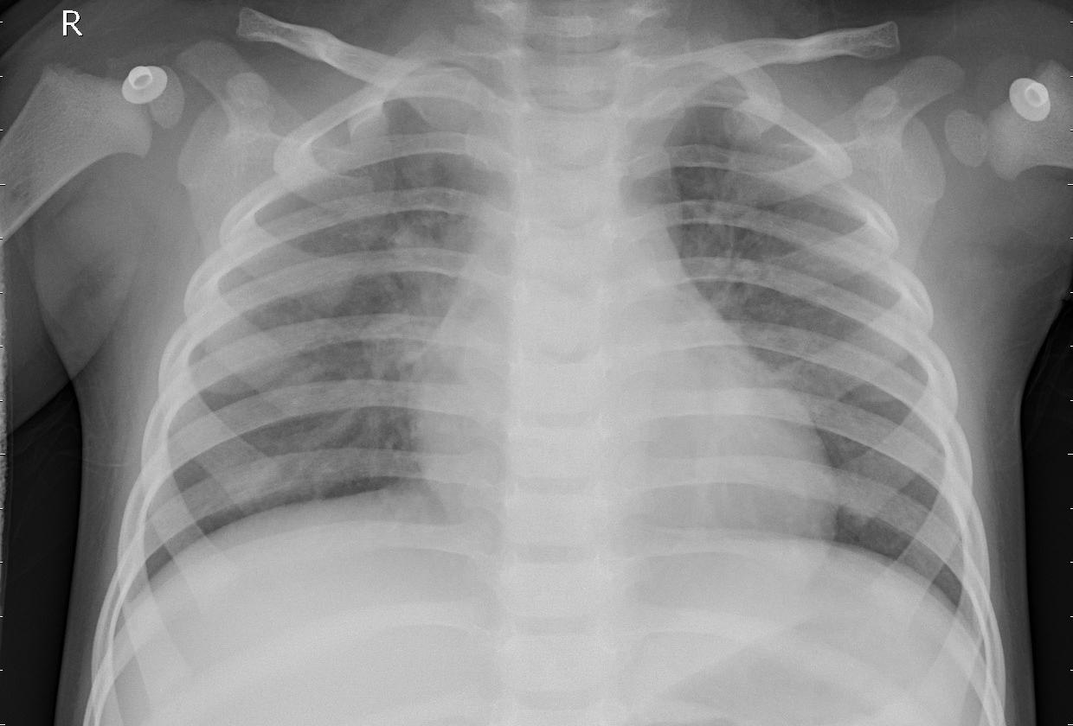
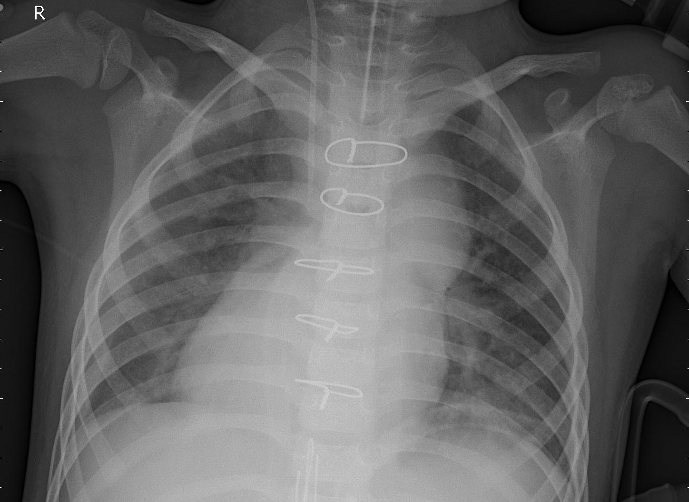
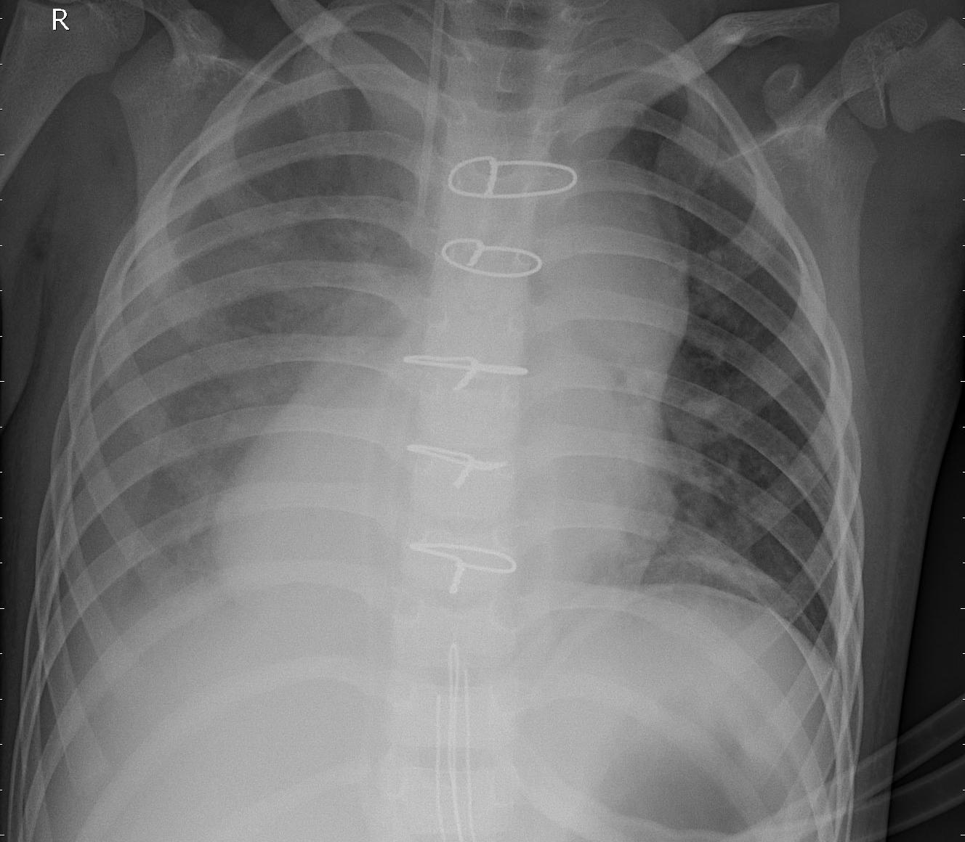
TEST IMAGES

Slide 20
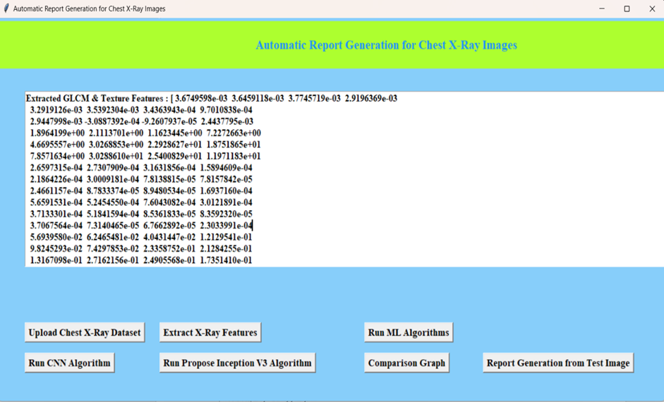
DATASETATA

Slide 21
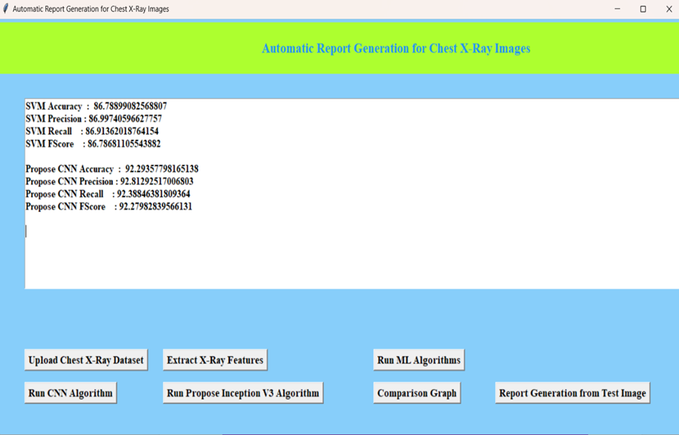


Slide 22
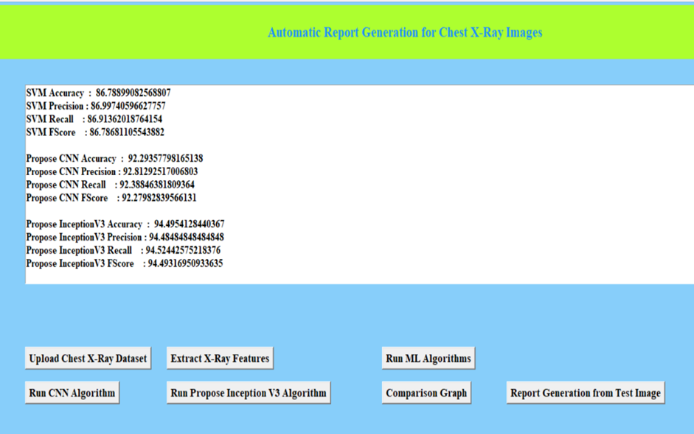

Slide 23
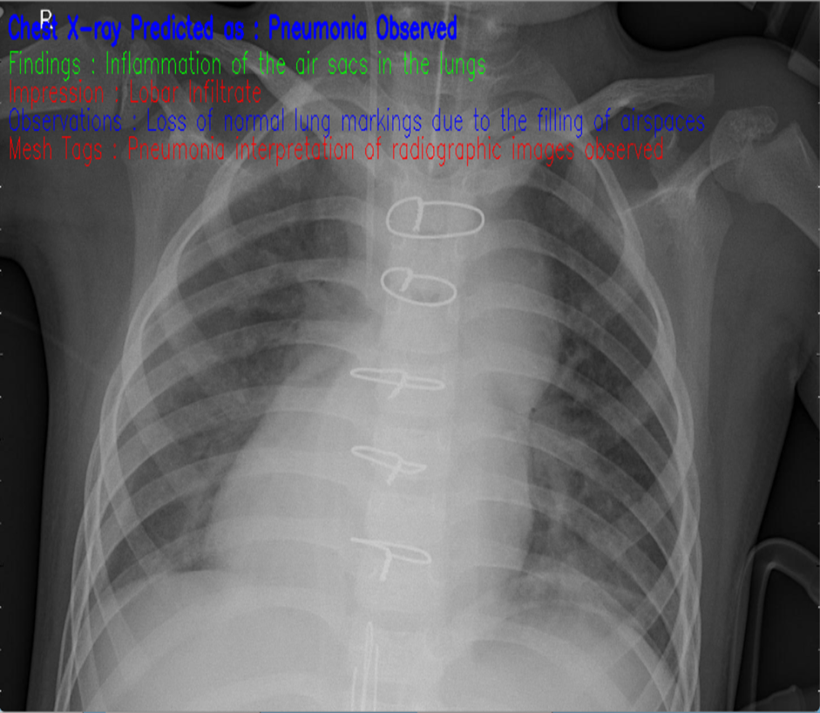
OUTPUT

Slide 24
CONCLUSION
In conclusion, the utilization of deep learning for chest X-ray image-based report generation marks a significant leap forward in radiology. By leveraging convolutional neural networks (CNNs) and natural language processing (NLP), this technology streamlines the report creation process, offering faster diagnoses and standardized reporting practices.
Despite challenges in model robustness and ethical considerations, the benefits of improved diagnostic efficiency and patient care outcomes are evident.

Slide 25
REFERENCES
S. Hochreiter and J. Schmidhuber, ‘‘Long short-term memory,’’ Neural Comput., vol. 9 no. 8, pp. 1735–1780, 1997.
B. Jing, P. Xie, and E. Xing, ‘‘On the automatic generation of medical imaging reports,’’ 2017, arXiv:1711.08195. [Online]. Available: http://arxiv. org/abs/1711.08195
G. Liu, T.-M. Harry Hsu, M. McDermott, W. Boag, W.-H. Weng, P. Szolovits, and M. Ghassemi, ‘‘Clinically accurate chest X-ray report generation,’’ 2019, arXiv:1904.02633. [Online]. Available: http://arxiv. org/abs/1904.02633

Slide 26
Y. Xue and X. Huang, ‘‘Improved disease classification in chest X-rays with transferred features from report generation,’’ in Proc. Int. Conf. Inf. Process. Med. Imag. Cham, Switzerland: Springer, 2019, pp. 125–138.
J. Yuan, H. Liao, R. Luo, and J. Luo, ‘‘Automatic radiology report generation based on multi-view image fusion and medical concept enrichment,’’ in Proc. Int. Conf. Med. Image Comput. Comput.-Assist. Intervent. Cham, Switzerland: Springer, 2019, pp. 721–729.
A. Vaswani, N. Shazeer, N. Parmar, J. Uszkoreit, L. Jones, A. N. Gomez, L. Kaiser, and I. Polosukhin, ‘‘Attention is all you need,’’ in Proc. Adv.Neural Inf. Process. Syst., 2017, pp. 5998–6008.

Slide 27

NIT
Department of Computer Science and Engineering

